Slide 1


Online Banking & Car Rental System
By Group 1
Group Leader: Aiza Ejaz
Group Members:
Mahnoor Yasir
Aleeza Azam
Shagufta Muntaha
Syeda Isma Nazir

Slide 2
Online Banking System
Class Hierarchy
Person Class (Base Class)
Employee Class (Base Class)
Account Holder (Derived from both base class using virtual inheritance)
Person Class
Attributes of Person Class
name, father name, dob, nationality, Cnic, address
Methods of Person Class
constructor, destructor, pure virtual function display info
Employee Class
Attributes of Employee Class
job, organization, empid
Methods of Employee Class
Constructor, destructor, virtual display employee info
Account Holder Class
Attributes of Account Holder Class
balance
Methods of Account Holder Class
constructor, withdraw, deposit, transfer, check balance, display info, operator overloading, destructor

Slide 3
Online Banking System
1. Inheritance: Account Holder inherits from Person and Employee.
Virtual Inheritance: Used in Account Holder to resolve the diamond problem.
Pure Virtual Functions: display Info in Person is a pure virtual function.
Constructors and Destructors: Used for initialization and cleanup.
Function Overloading: Different versions of functions for various operations (deposit, withdraw, transfer, check balance).
Function Overriding: display Info in Account Holder overrides the pure virtual function from Person.
Operator Overloading: Overloaded << operator for Account Holder.
Friend Functions: << operator declared as a friend of Account Holder

Slide 4
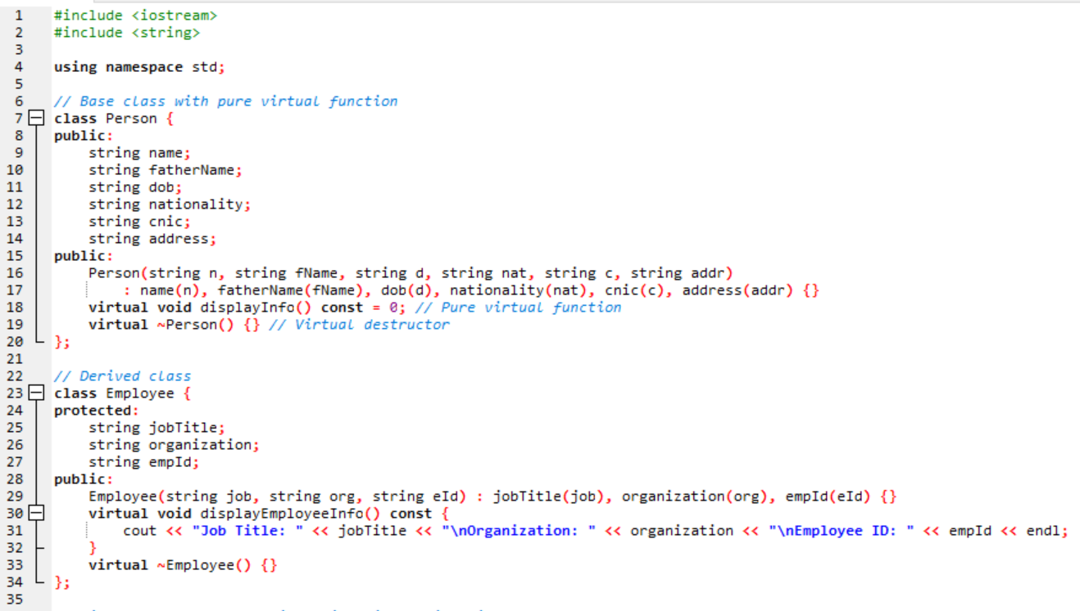

Slide 5
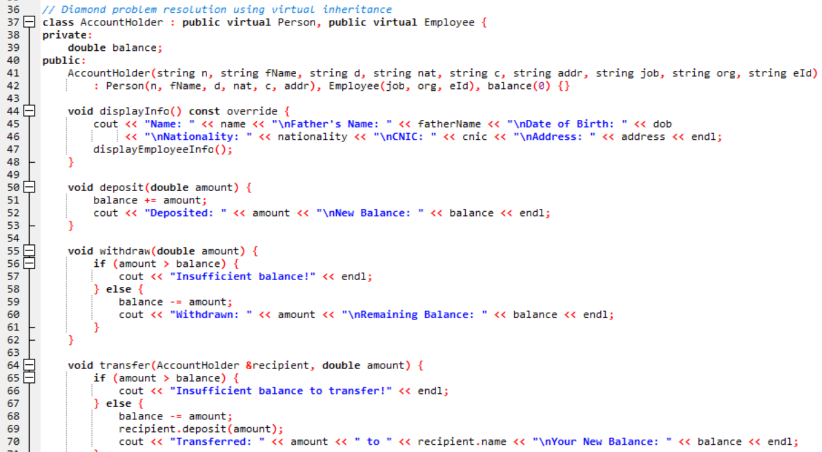

Slide 6
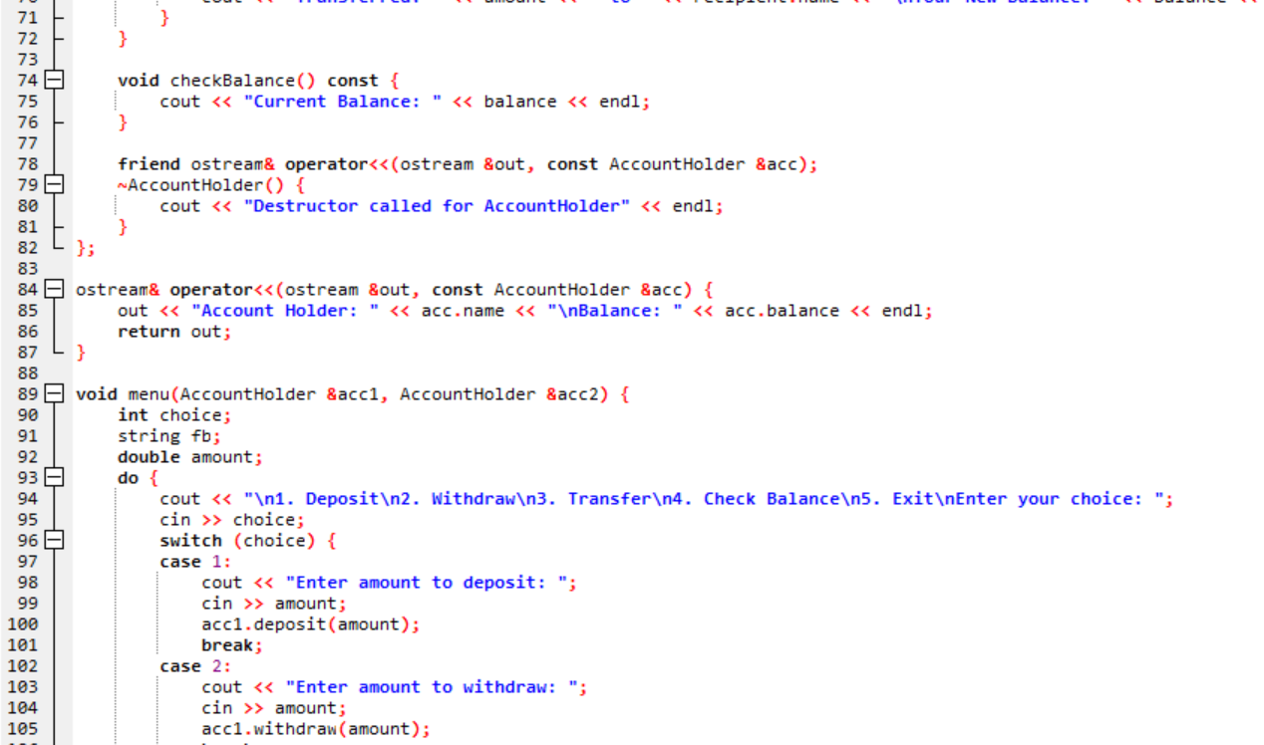

Slide 7
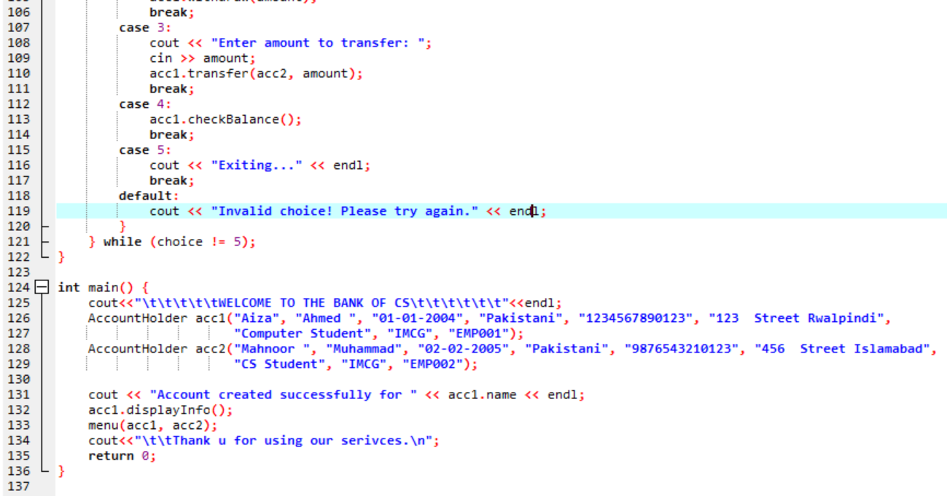

Slide 8
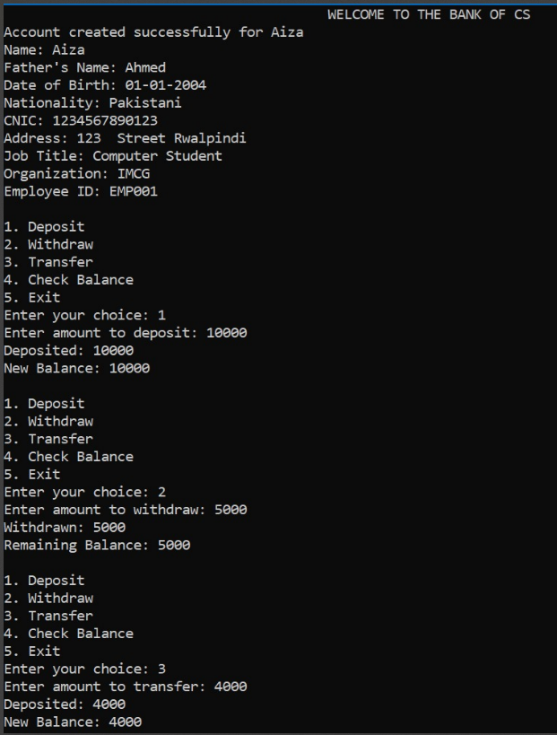

Slide 9
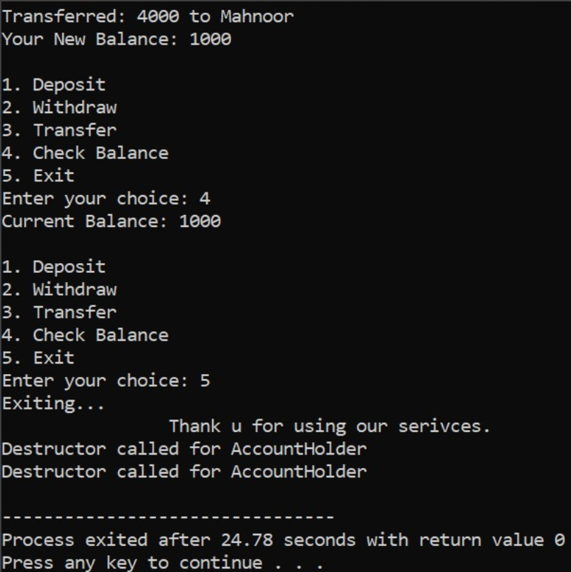

Slide 10
Car Rental System
Consider a scenario where you need to model different cars in a car rental system. You have a base class Car with a virtual function display Specs(), which displays the car's specifications. Implement two derived classes Normal Car and Luxury Car, each representing a specific type of car. Override the display Specs() function in each derived class to provide the appropriate display behavior for the respective car type. Additionally, implement a Rent class that has a Car object as a member variable and demonstrates the usage of function overriding by calling the display Specs() function on the Car object. Finally, create objects of each car type and call the display Specs() function to demonstrate the usage of function overriding.

Slide 11
Main Features Of Program
A base class Car with attributes like name, color, mileage, fuel average, transmission, rate per hour, speed per kilometer, and a boolean flag for rental status.
Two derived classes, Normal Car and Luxury Car, which inherit from the Car class.
A Rent class that represents a car rental, including methods to display car specifications, calculate the total cost of rental, check availability, and rent a car.
An Account class to store and display account details.
In the main() function, an array of 8 cars (4 normal and 4 luxury) is created, and the user is prompted to choose a car type, select a car, rent it, and optionally provide account details.
Error handling is implemented using a try-catch block to handle runtime errors.
Finally, the program deletes the car objects and terminates

Slide 12
Main Concepts Used
Inheritence
Abstraction
Encapsulation
Constructor
Destructor
Virtual function (polymorphism)
Polymorphism (override)
Dynamic memory allocation/deallocation
Exception handling

Slide 13
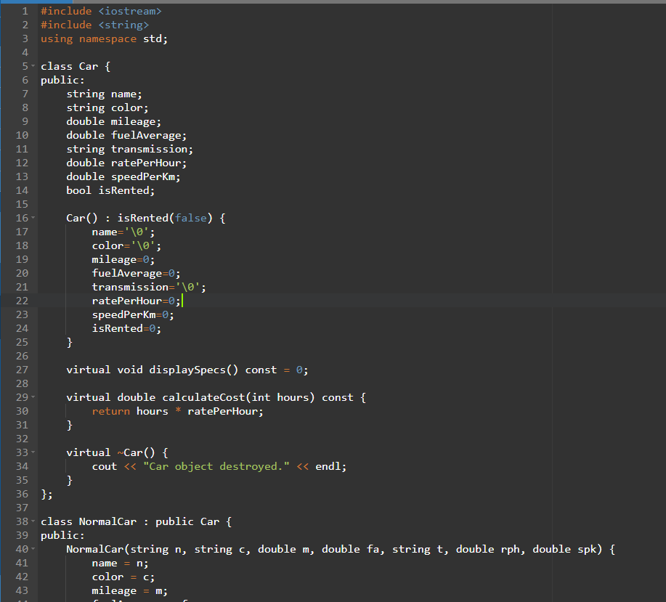

Slide 14
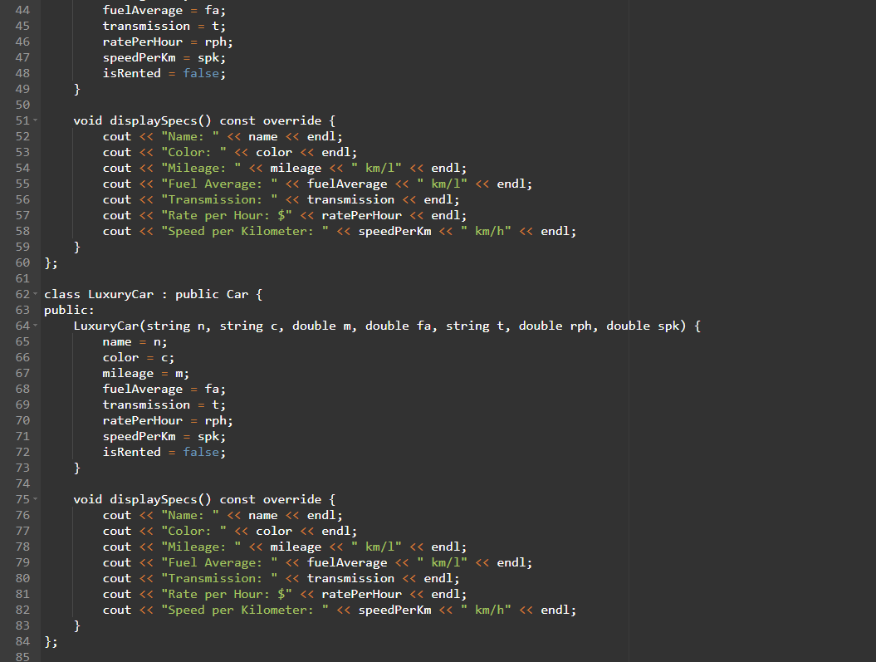

Slide 15
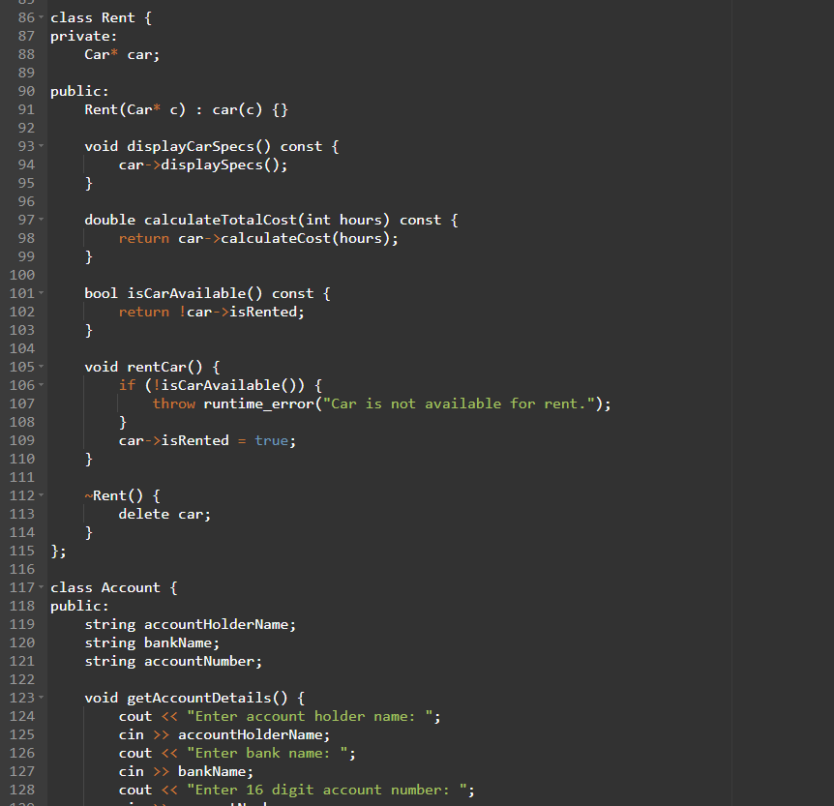

Slide 16
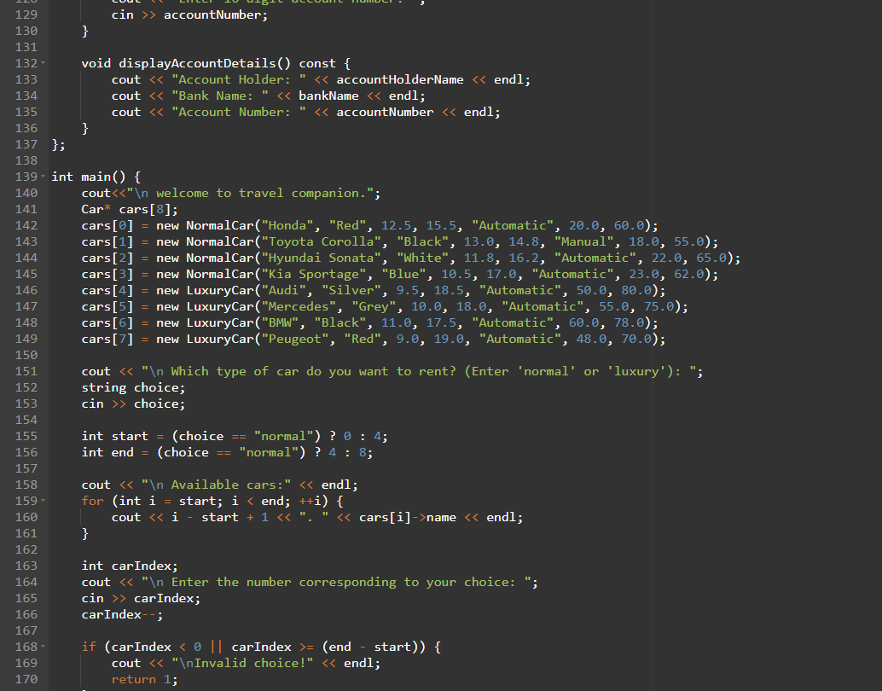

Slide 17
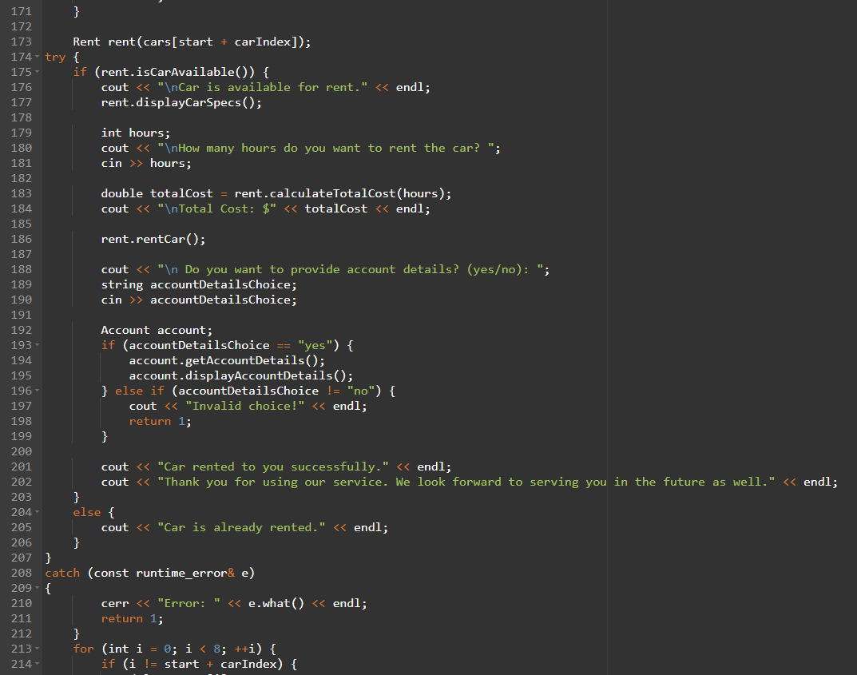

Slide 18
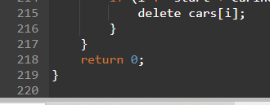

Slide 19
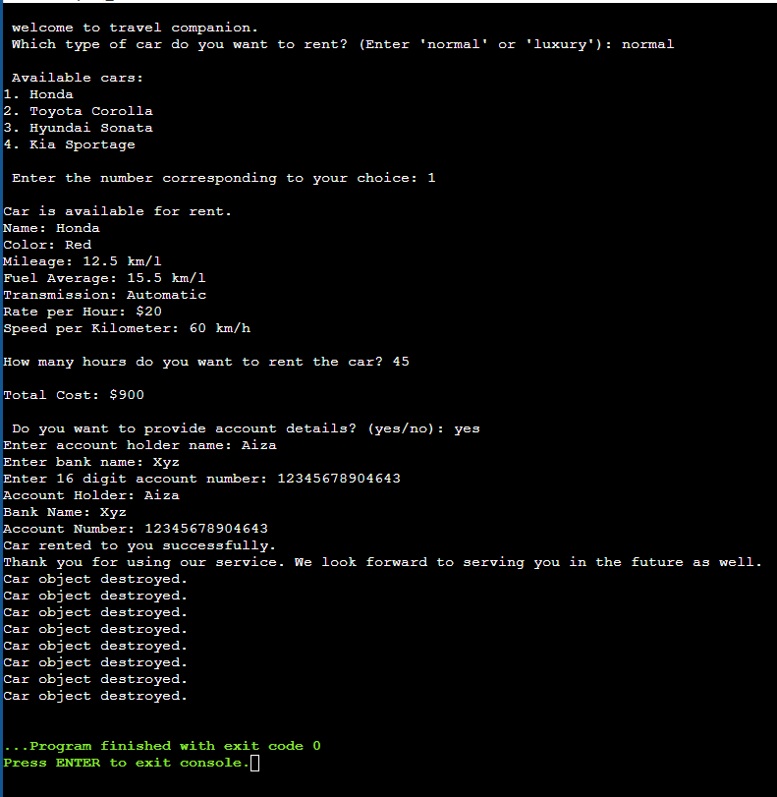
Output of this program may vary according to the users choice

Slide 20
Thank you for Your Time And Concentration!

